Slide 2
Plasma Assisted Combustion and Ignition
Direct Control of Flame Behavior and Chemistry
Gabe Xu, Ph.D.
Associate Professor
Mechanical and Aerospace Engineering
February 22, 2019

Slide 3
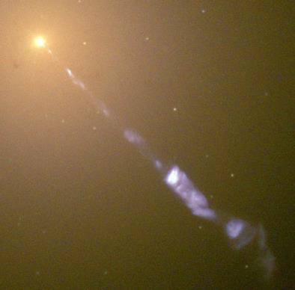
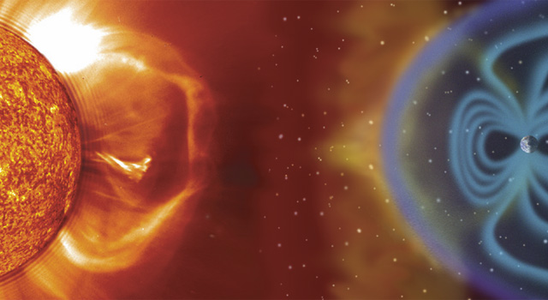
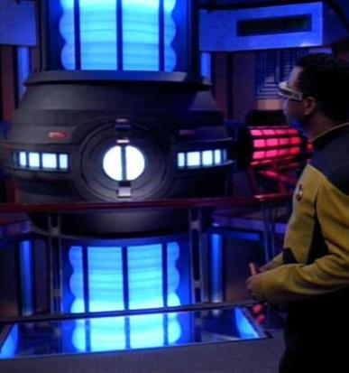
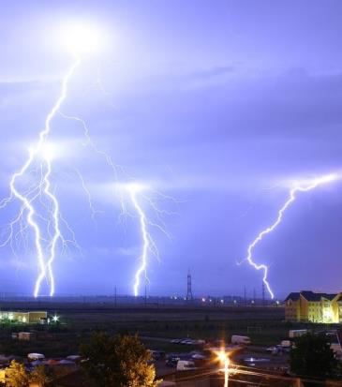
What is Plasma
4th state of matter
  ~99% of known universe
Gas with separate positive and negative charged particles
  Electrically conductive
  Responds to external electromagnetic fields
  Obtained by super heating/energizing a gas
Notes:
M87 supermassive galaxy in Virgo constellation. Center is supermassive black hole that emits relativistic plasma jet 5,000 light years long.

Slide 4
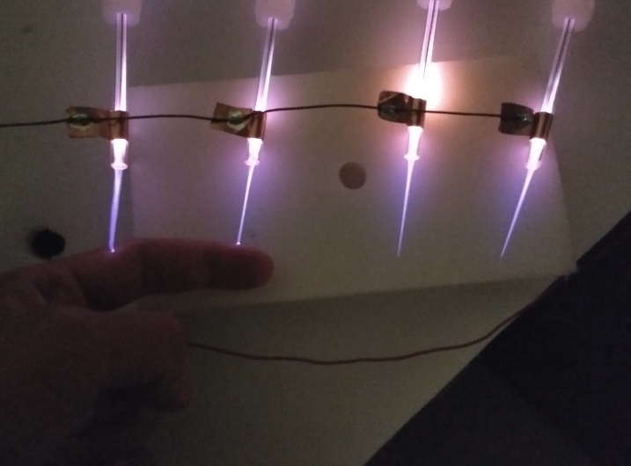
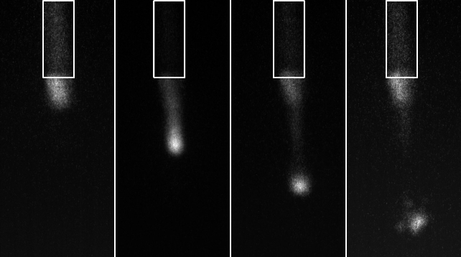
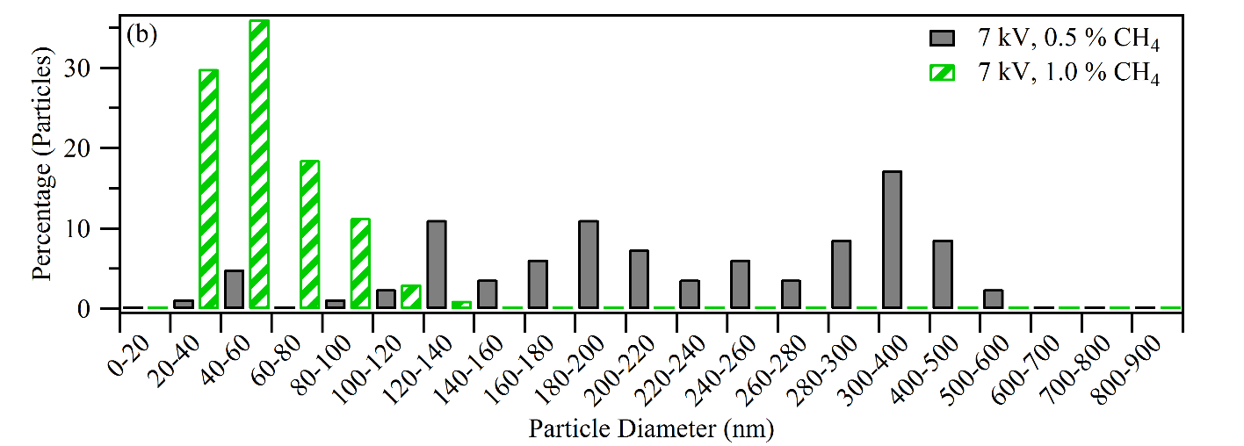
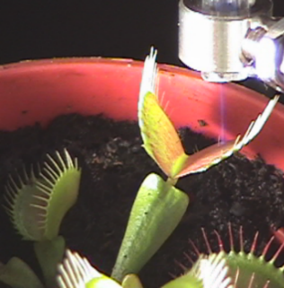
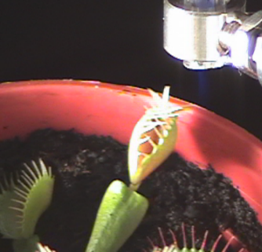
Plasma Electrodynamics and Research Lab (PERL)
Atmospheric Plasma
Nanomaterial synthesis
Diode pumped laser gain medium
Bio and soft material treatment

Slide 5
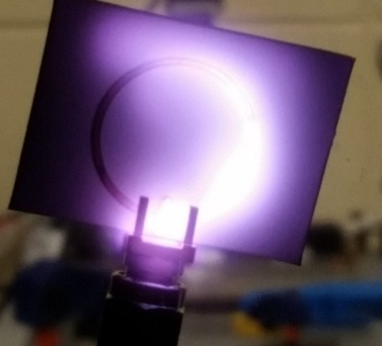
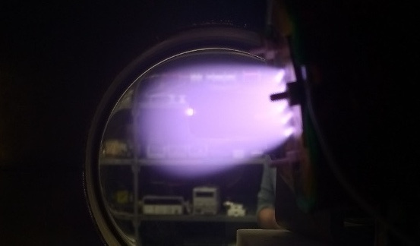
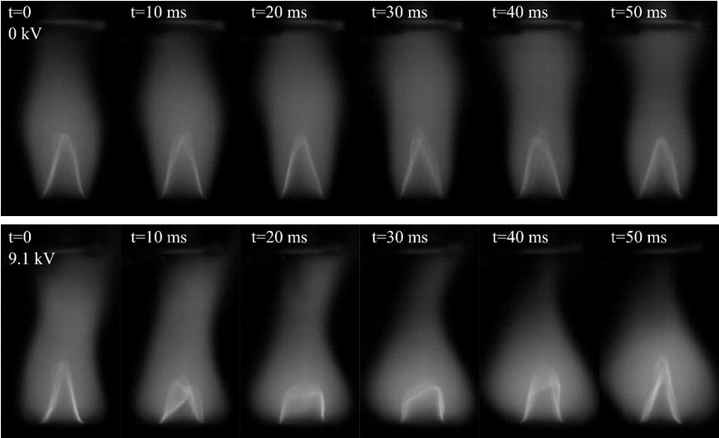
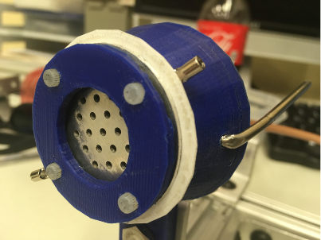
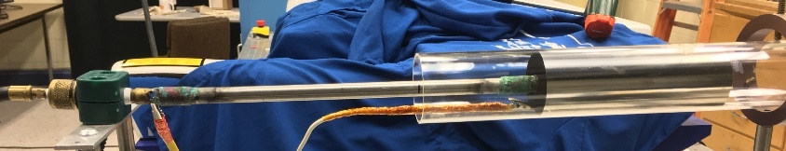
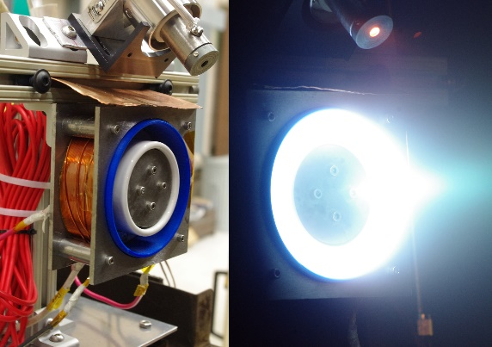
Plasma Electrodynamics and Research Lab (PERL)
Miniature electric propulsion
Split-ring resonator ion engine
Use 3D printing for EP
Plasma Assisted Combustion (PAC)
Electric field flame response
Instability damping
Notes:
At the Plasma and Electrodynamics Lab we work in three main areas.
In-space micro propulsion for small satellites. We are using modern manufacturing techniques to build and test a printable plasma generator for using in a 3D printed micro thruster. (LEFT) One of the split-ring resonators operating in vacuum. The pink glow is plasma generation. (Middle) A solid model of a proposed thruster design. The overall dimensions are 1 in. diameter and 1.5 in. long. (Right) A Cubesat, which is the one of the target uses for this technology.
Atmospheric plasmas. In addition to studying their basic physics, we are investigating the synthesis of nanomaterials. This would be an advantage over current vacuum plasma methods due to the lack of the expensive vacuum system. (Left) Photo of the system running with plasma jet coming out. (Right) SEM images of our deposited carbon nanospheres through breakdown of CH4.
Plasma assisted combustion. Study how electromagnetic fields interact with combustion chemistry. Seeking to find way to improve combustion efficiency and control. (Top) High-speed images over 136 ms of a diffusion flame under no electric field showing a laminar flame with regular fluctuations. (Bottom) 360 ms time lapse at 10 kV electric field showing significant turbulent flame structures and no regularity.

Slide 6
Combustion Chemistry
Combustion is simply reaction of molecules that produce heat
CH₄ + 2O₂ → CO₂ + 2H₂O + heat
  But not actually that direct. Actually bunch of smaller reactions
  O₂ → 2O
  CH₄ + O → OH + CH₃
Reaction controlled by temperature, pressure, and concentrations of species
  Normally you can only control T and P, but with plasma, can possibly control species

Slide 7
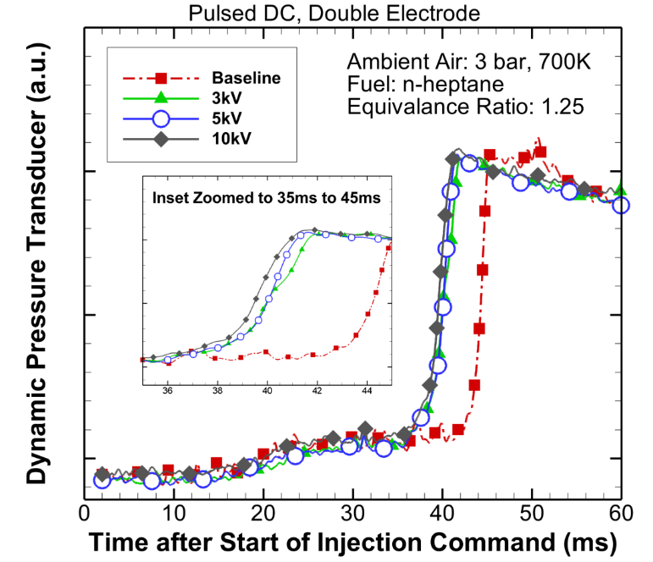
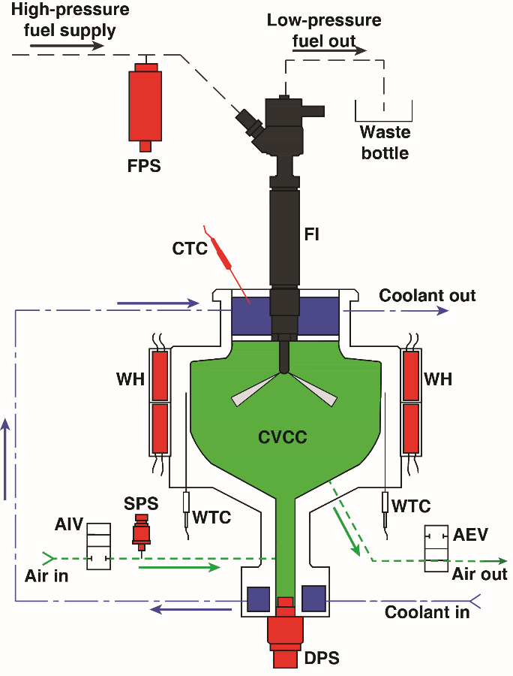
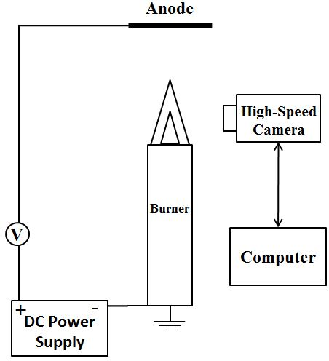
PAC and PAI
Hydrocarbon flames naturally generate charged particles
  Flames considered weakly ionized plasma
2 ways to affect combustion
  Passive: Use existing ions and electrons
  Active: Generate additional ion, electrons, and neutral species (O, OH, etc)

Slide 8
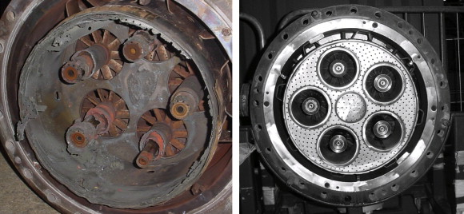
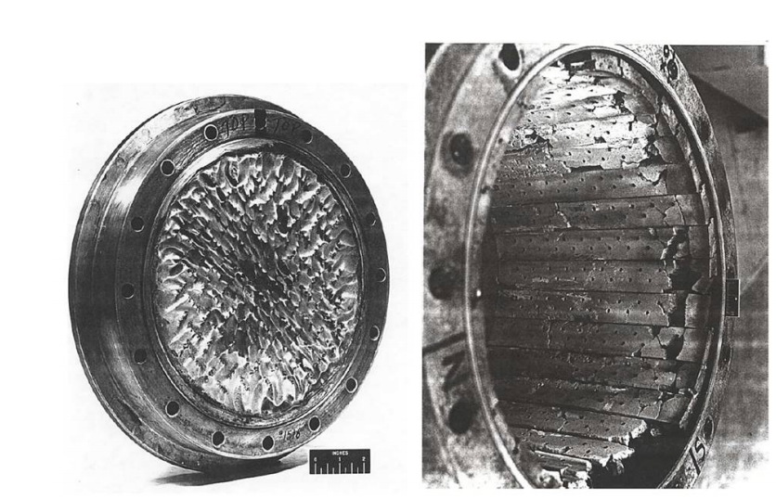
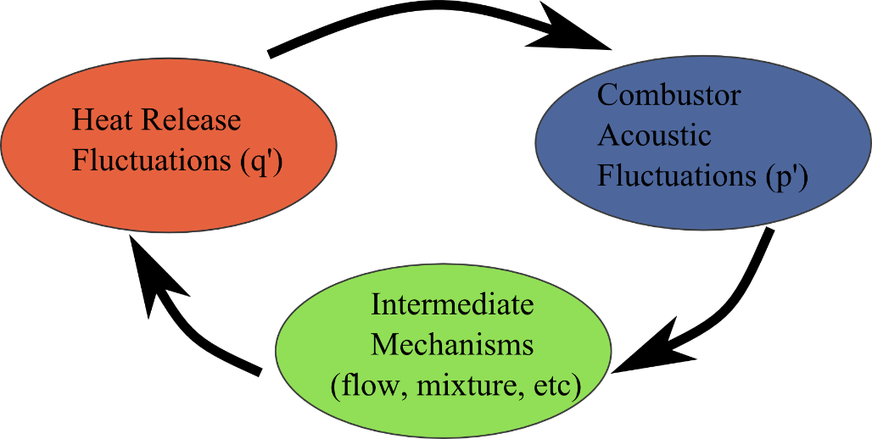
E Field Damping of Instabilities
Combustion instabilities potentially damaging to engines
Thermoacoustic instabilities couple flame dynamics to chamber acoustics
  Most damping mechanism affect acoustics or fluid flow
  What about heat release fluctuations? (chemistry)
(Lieuwen and Yang, Prog. Astro. & Aero., 2005)
?
(Yang and Anderson, Prog. Astro. & Aero., 1995)

Slide 9
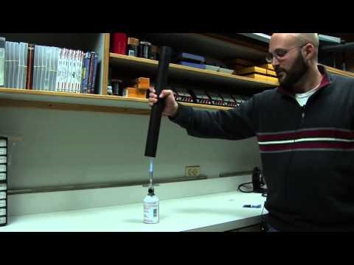
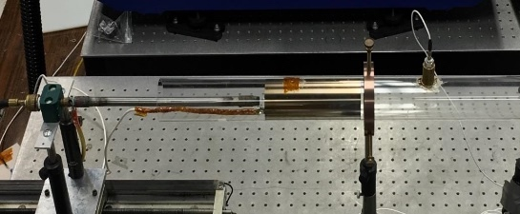
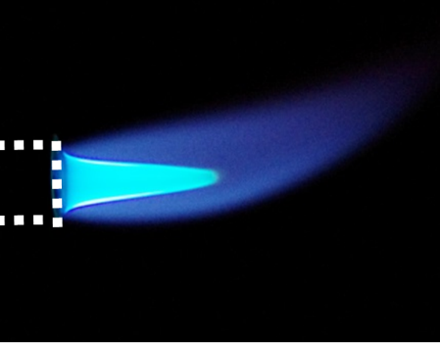
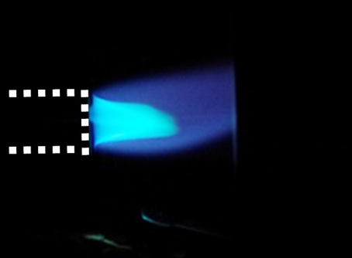
Instability Damping in Rijke Tube
PCB transducer
Steady
premix
flame
Unsteady
premixed
flame

Slide 10


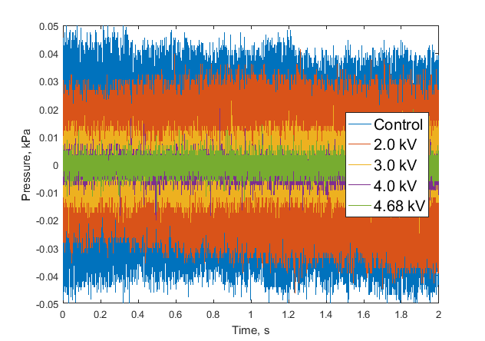
Instability Damping in Rijke Tube
Unsteady
flame due to thermoacoustics
Re-stabilized flame
High Voltage

Slide 11
Results
1st experimental demonstration of E field active damping of thermoacoustic instabilities
  Work done entirely by undergraduate student
  Published in Journal of Propulsion and Power
    Henderson, Xu, JPP, V34, No1, 2018
  Turbulent flames harder to dampen
  Strong function of electrode size and location

Slide 12
Looking Forward
PAC and PAI can improve combustion
  Most work at atmospheric pressure
  Need higher pressure results for practical engine conditions
New areas of interest
  Control of engine ignition delay
  Plasma enhanced RDEs for modern fuels

Slide 13
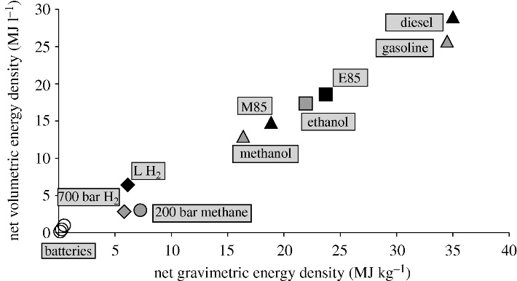
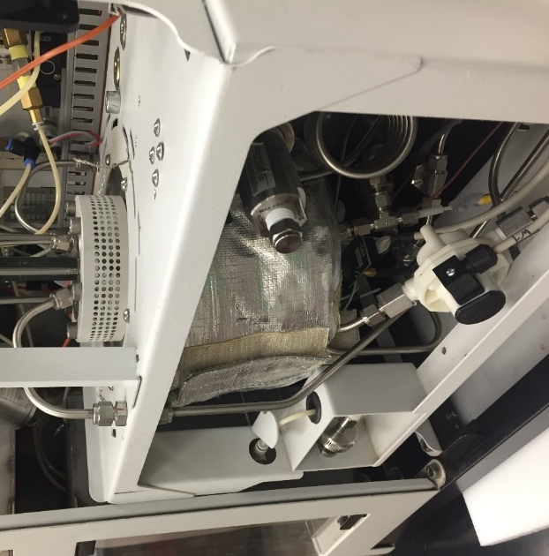

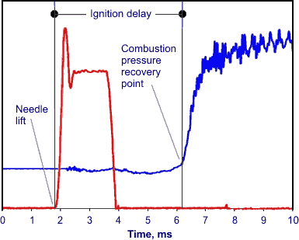
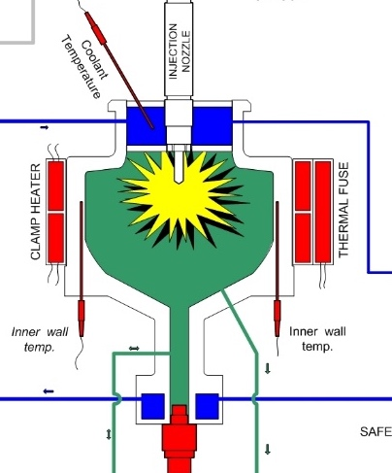

PAI for Diesel Ignition Control
Diesel fuel tester at UA

Slide 14
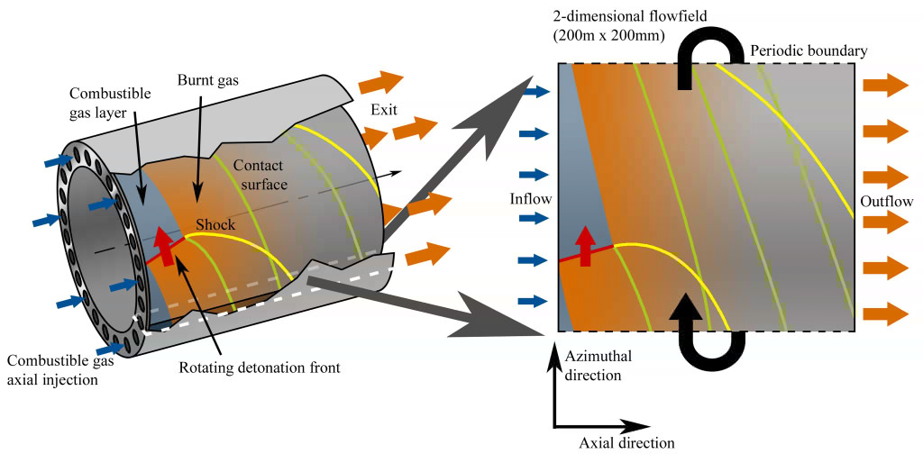
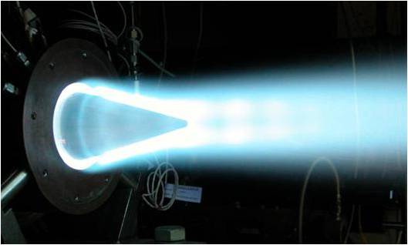
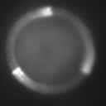
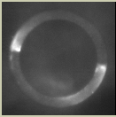
Plasma-Enhanced RDE
Rotating detonation engine (RDE)
  Moving shockwave in annulus compresses and burns propellant
  Operation from subsonic to supersonic flow
  Higher efficiency and lower weight than modern engines
(Aerojet-Rocketdyne)

Slide 15

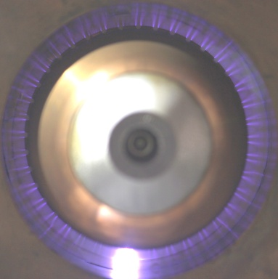
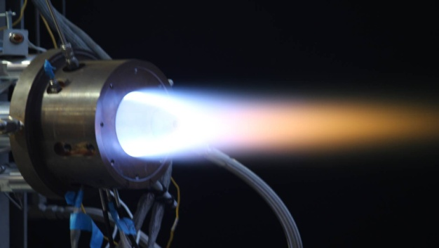
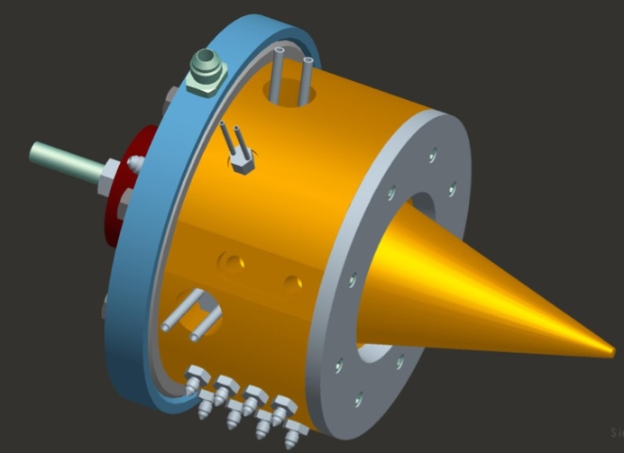

Plasma-Enhanced RDE
Ground based gas turbines use CH₄+air, and jet engines use air + jet fuel
  RDE channel width ~3 x detonation cell size
  H₂ + O₂: cell size ~ 1.5 mm
  H₂ + air: cell size ~ 15 mm
  Hydrocarbons (CH₄ and jet fuel): cell size ~ 10’s cm
  Can’t be used in small RDEs, large ones loose compactness benefit
Plasma discharge can make it work in small RDE
  Similar as diesel PAI, generate extra combustion species
(Aerojet-Rocketdyne)

Slide 17
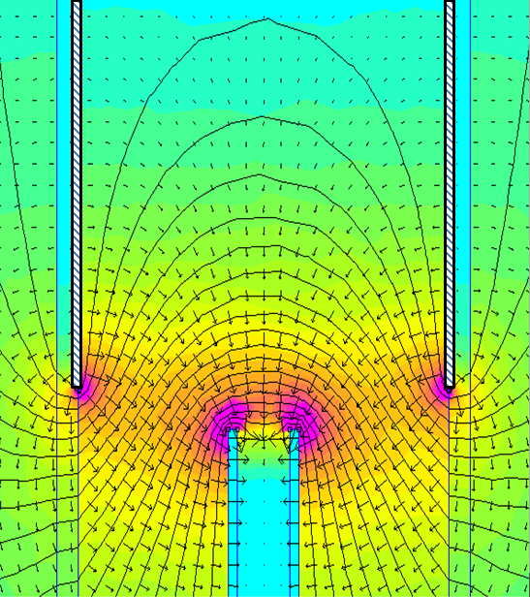


Ionic Wind Body Force
+
-
-
+
-
+
+
+
-
Bulk flow
-
n
n
+
-
+
n
n
-
n
n

