Slide 1



FOCUS 2
An Online
Career,
Major
& Education Planning
System
Career Planning Readiness
Self Assessment
Major and Career Exploration
Action Planning, Decision Making

Slide 2

HIGH PRIORITIES:
CHOOSING YOUR MAJOR, GETTING AN EDUCATION & MAKING INFORMED CAREER DECISIONS
Notes:
This is another option for an overview using transitions to advance through several slides.

Slide 3


Reality: 60% of Entering Freshmen…
NO
MAJOR
(Deciding)
NO
PLAN
NO
CAREER
GOALS
“I Have To Declare A Major?”
Notes:
This is another option for an overview using transitions to advance through several slides.

Slide 4

What is
Career & Education Planning?
Orientation, Self Knowledge Discovery, Exploration,
Decision Making,
Action, Adaptation
A continuous, lifelong process
of exploration and planning of career and educational goals compatible with your interests, values, talents, personality and aspirations.

Slide 5

Research Findings:
Benefits of Career Planning
Facilitates more appropriate goal setting, academic decision making, and course selection which heightens commitment, and the probability of retention.
John Gardner (1998, 2003) Nationally known for his work on improving the college freshman experience and raising student retention rates.
Increased motivation, improved academic achievement, increased retention, and less time to graduate.
(Gillie, S. & Gillie-Isenhour, M., 2005)
Timely college degree attainment influenced
by the interests / major congruence of students.
(Allen, J. & Robbins, S., 2010)

Slide 6
Career Myths
There is only one perfect job/career for you.
Your major will guide you to your career.
Your career choices are lifelong decisions.
Liberal arts, humanities and sciences are not marketable majors.
Your career decisions should be based on the current job market.

Slide 7

Understanding yourself is the first step of career & educational planning
Step 1: Identify your interests, personality, values, skills and lifestyle preferences
Step 2: Explore occupations and major areas of study compatible with your personal attributes.

Slide 8

Your Life Plan
As you plan your career you should consider the big picture…your life plan. Your career decisions will dramatically impact your lifestyle.
Where you live | Your income | Time at home
Your work hours | Your travels | Job security
Your work associates | Your choice of friends | Your leisure time

Slide 9
It is your future. Take charge.
  You are responsible for making your education and career decisions, managing your career and controlling your destiny.
  Your career will affect your future lifestyle and feelings of fulfillment as well as where & how you live, your financial security, your leisure time activities, etc.

Slide 10


Understand the World of Work
Today's rapidly changing world:
  new occupations are emerging, others are disappearing
  existing jobs are demanding higher levels of skills

Slide 11

Plan for the Present and Future
Be ready for change with career goals, strategies and options based on your interests, personality, values and skills.
With a plan, you will be equipped to manage your career and take advantage of changes in the economy and job market rather than becoming a victim of change.

Slide 12
Plan your career
Be Proactive
Fine Tune
Career Planning is an ongoing process throughout all your life stages.
Be forward-looking with your planning, develop new skills and be prepared to make changes as needed.

Slide 13

Start the Process
Use FOCUS 2
Make informed decisions

Slide 14
What is FOCUS 2?
FOCUS 2 is an online, interactive,
self-guided career, major and education planning system.

Slide 15
Why use FOCUS 2?
Are you unsure of your major?
Are you unaware of the majors offered at your college and related occupations?
Are you wondering what to do with your major?
Are you unsure of which careers best suit you?
Would you like to develop a career plan that works for you?
Are you ready to make informed career decisions?

Slide 16

FOCUS 2 Can Help You:
  Select a major based on your interests and aspirations
  Discover occupations matching your personal preferences and attributes
  Map out your career plans, present and future
  Make informed career decisions

Slide 17

Use FOCUS 2 as an ongoing resource throughout your academic years and as an alumnus.
“I am completely unsure about my major and career and how to begin the career planning process.”
“I have some ideas about my major and career but I need to learn more about the tools and resources.”
“I am ready to make informed decisions about my education and career.”

Slide 18
FOCUS 2 Decision Making Model
Ready
Career Planning Readiness: Orientation to FOCUS 2 & the Career Planning Process
Assess
Explore
Explore Options: Identify and explore Majors & Occupations matching personal attributes
Decide
Decision Making: Select Major & explore Career Paths
Action Plan: Map out steps to achieve goals
Assessment of Interests, Personality, Skills, Values, Needs

Slide 19
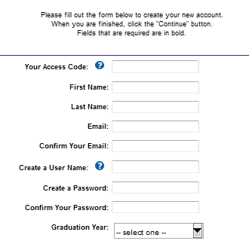
Getting Started with FOCUS 2
Create your FOCUS 2 account
The access code can be obtained from your career counselor or advisor.

Slide 20
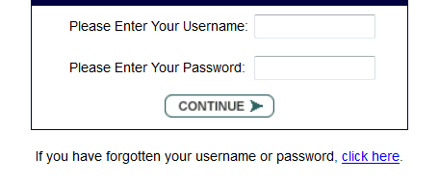
Use FOCUS 2 anytime, anywhere.
Online, Available 24/7 on any PC, Mac, Ipad
FOCUS 2 saves all your results.
Log in anytime, as often as you wish.
The user name and password are CaSe sEnsiTive!!!
If you forget your username or password, FOCUS 2 will email it to you.

Slide 21
THE FOCUS 2 Main Menu
Using FOCUS 2
The Main Menu is divided into 6 sections that mirror the career planning process.

Slide 22
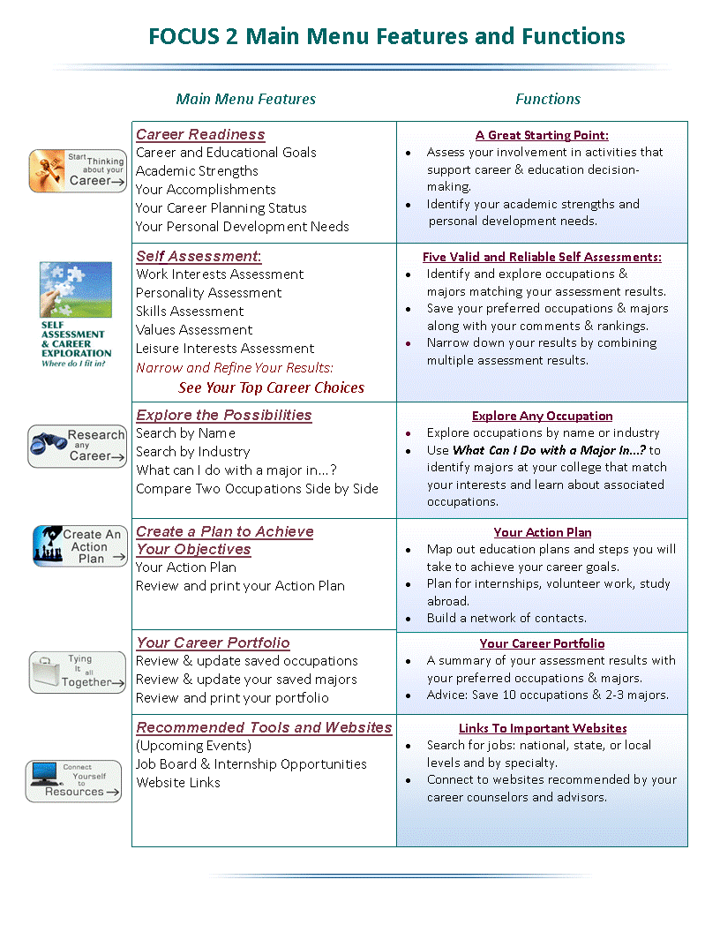
FOCUS 2
is user friendly and will guide you through the career & education planning process.

Slide 23

The following slides will introduce you to the FOCUS 2 Main Menu and the functions of each section of the menu.

Slide 24

Career Readiness
Your Career Planning Status highlights activities that support informed decision making.
A Great Starting Point
CAREER READINESS
Career and Educational Goals
Academic Strengths
Your Accomplishments
Your Career Planning Status
Your Personal Development Needs

Slide 25

Self Assessment
Save 10 preferred occupations & 2-3 majors
SELF ASSESSMENT:
Work Interest Assessment
Leisure Interest Assessment
Skills Assessment
Personality Assessment
Values Assessment
Narrow and Refine Your Results:
See Your Top Career Choices

Slide 26
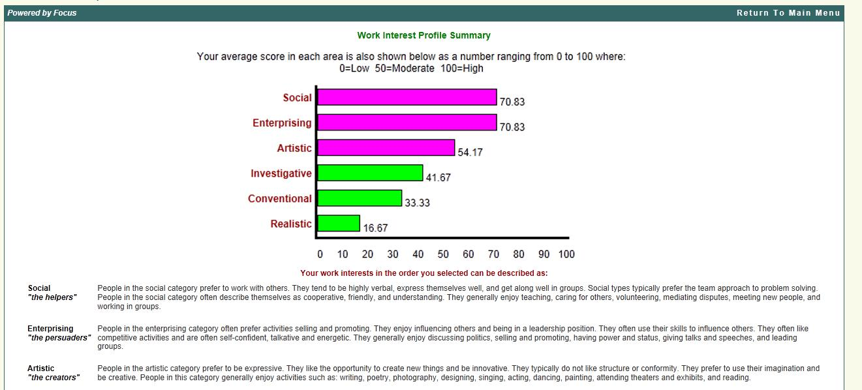
Sample Interest Profile
Your top 3 interests make up your Holland Code (Interest Profile).

Slide 27
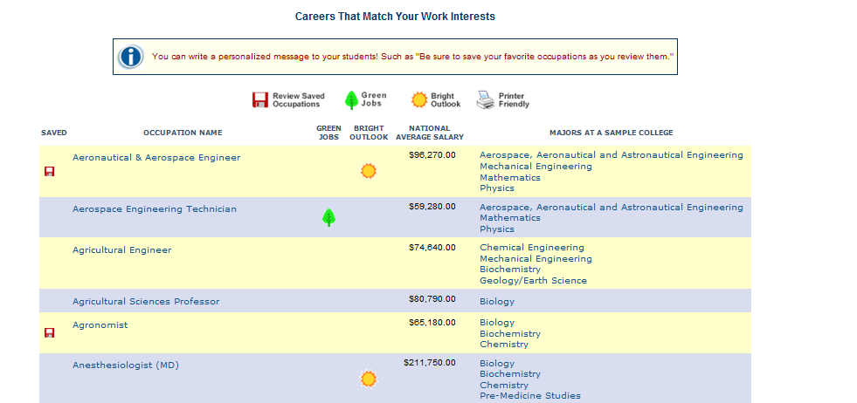
Your interest profile is matched to:
1. Occupations with similar interest profiles
2. Supporting majors at your college
OCCUPATIONS
MAJORS
Save your favorite occupations and majors

Slide 28
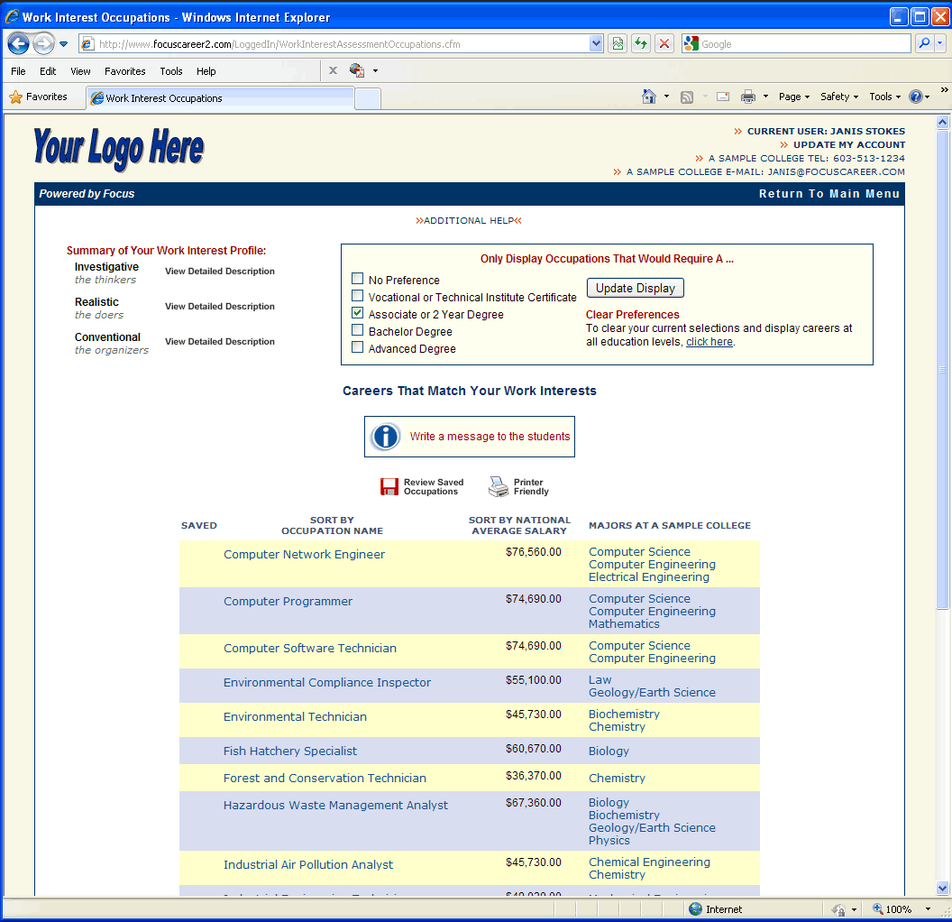
Explore Your Assessment Results
Vary the degree level to play the “What if?” game.
How does degree level impact the opportunities available in a career field?

Slide 29
Exploring Majors?
Examine the supporting majors offered at this college

Slide 30

Click on any occupation to learn more
MENU
Overview
Job Duties
Skills
Values
Outlook
Earnings
Advancement
Interest Profile
Working Conditions
Contact Info
Areas of Study
Overview
Archeologist
Archeologists research the materials and records of
past cultures, countries, tribes, and early prehistoric
man in order to reconstruct and understand their
origin and development. They excavate, analyze,
classify and interpret artifacts and weapons to identify
trends.
Graduates with a master's degree in archeology can qualify for a teaching position in two-year colleges, while a Ph.D. is usually the minimum requirement for most teaching positions in 4-year colleges. Training in statistics is essential for those who wish to find research positions in government agencies or in social science research institutes.
Play Video
Save this
occupation
Printer Friendly

Slide 31
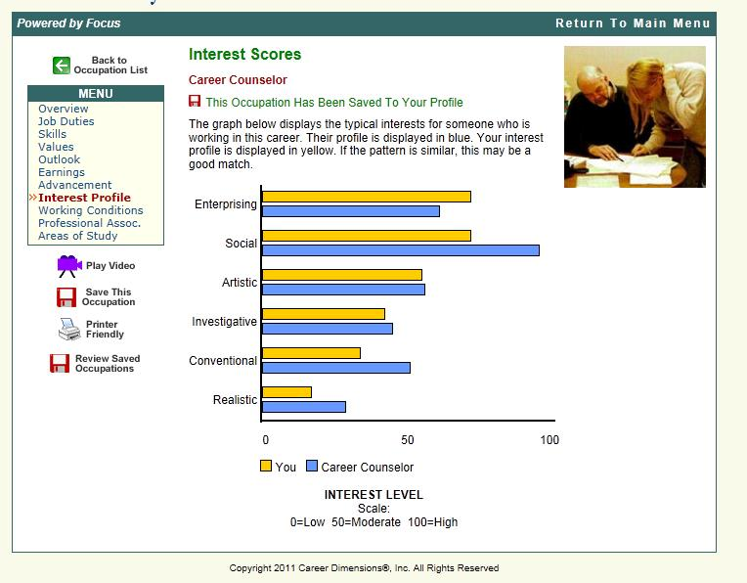
Compare your interest profile to the interest profile for the occupation
Example of a good match

Slide 32
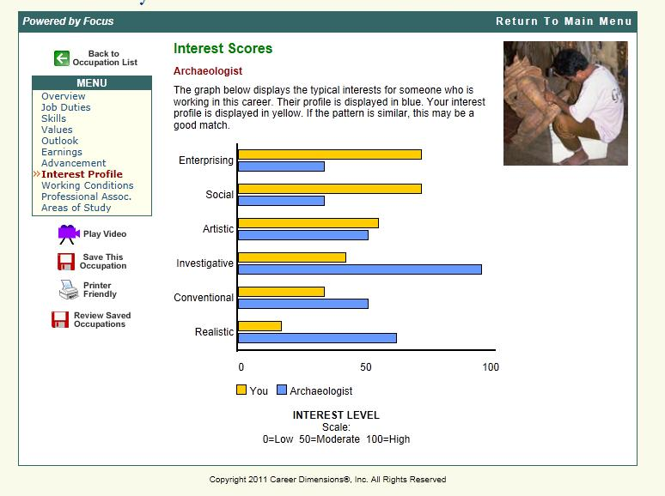
How well do your interests match the interest profile (Holland Code) for the occupation?
Example of a poor match

Slide 33
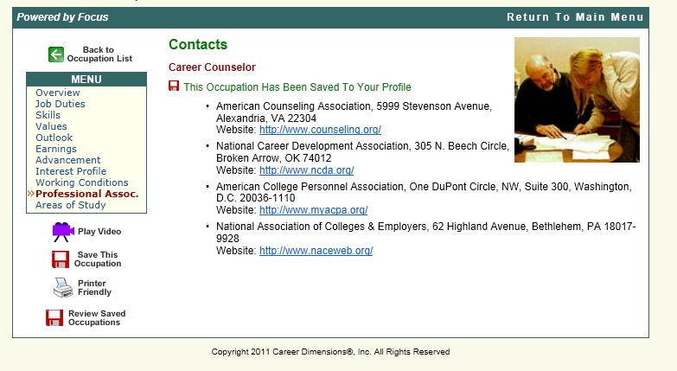
Connect to Professional Associations

Slide 34
Narrow Your Self Assessment Results
“See your Top Career Choices” displays your top choices by combining your assessment results.
Click on See Your Top Career Choices to narrow your results.
SELF ASSESSMENT:
Work Interest Assessment
Leisure Interest Assessment
Skills Assessment
Personality Assessment
Values Assessment
Narrow and Refine Your Results:
See Your Top Career Choices

Slide 35

Explore the Possibilities
Use the tools in FOCUS 2 as an ongoing resource.
EXPLORE THE POSSIBILITIES
Search by Name
Search by Industry
What can I do with a major in...?
Compare Two Occupations Side by Side

Slide 36
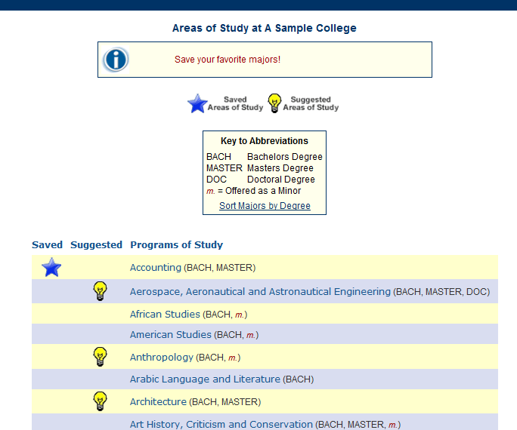
Your Interests Suggested Majors
Choosing your major?
Use “What Can I Do with a Major In…?”
FOCUS 2 identifies majors that match your interests

Slide 37
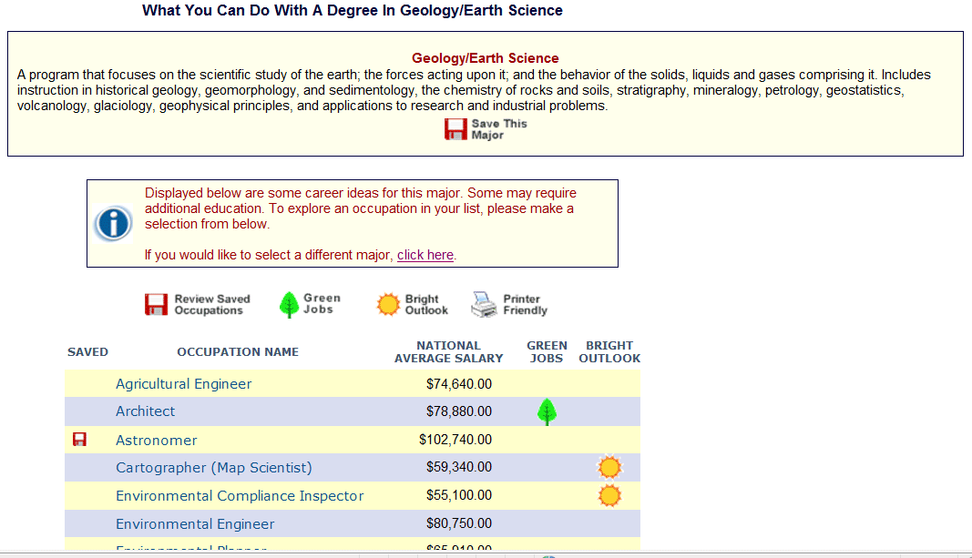
Choosing your major?
Use “What Can I Do with a Major In…?”
Are the occupations associated with a major appealing to you?

Slide 38

Action Plan
Build your network of contacts
Plan for Internships, Study Abroad, Volunteering
Create an Action Plan
Build Your Action Plan
Review & Print Your Action Plan

Slide 39

Your Career Portfolio
FOCUS 2 saves all your results, questions & preferences in Your Career Portfolio
YOUR CAREER PORTFOLIO
Review & Update Your Saved Careers
Review & Update Your Saved Majors
Review & Print Your Portfolio

Slide 40
Follow up
  Discuss your results with your career counselor/ adviser
  Understand how your interests, skills, personality type and values will be an asset to you in the world of work

Slide 41

Recommended Tools and Websites
Explore job postings nationally, by state, employer type, specialty -green jobs, international, etc.
RECOMMENDED TOOLS AND WEBSITES
Upcoming Events
Job Boards and Internship Opportunities
Links to Helpful Websites

Slide 42


Slide 43
FAQ
In what stage of your education should you use FOCUS 2?
FOCUS 2 can be used in different ways throughout all stages of your education according to your personal needs.
While in College:
Explore majors at your college that support your assessment results
Explore career options
Make decisions
Graduating or Alumni:
Explore career options
Plan for additional education and training
Make career plans

Slide 44
FAQ
Where and when can you use FOCUS 2?
Anywhere, anytime, 24/7
Contact your college’s FOCUS 2 administrator for the
Access Code to register.
Where should you start on the main menu and can you use FOCUS 2 more than once?
Start with any feature on the Main Menu you wish to use. The lay out of the main menu mirrors the career planning process.
Repeat any feature. Use FOCUS 2 as often as you wish.

Slide 45
FAQ
Will FOCUS 2 save your Self-Assessment profile results and are your results confidential?
Yes, FOCUS 2 will save all your results under your confidential user name and password. Only you and your career advisor have access to your results.

Slide 46
FAQ
Are printouts of your results available?
Yes, you can print your results by selecting Review and Print My Portfolio on the Main Menu.
Can you change your account details such as your password, email address etc.?
Yes, log in and go to the FOCUS 2 Main Menu. Click on “Update My Account” located in the upper right hand corner of the page and make your changes.

Slide 47
Remember, career planning involves thinking about which educational and occupational paths will provide you with satisfaction and fulfillment in all aspects of your life, not only in the present, but in the future.

Slide 48

FOCUS 2: YOUR CAREER PLANNING RESOURCE

