Slide 1


Beyond the Interview: How to Hire your Employer
Presented by the Office of Career Development

Slide 2
The Interview Process
Initial Interview
Second Interview
1
The initial interview allows you and the employer to begin seeing if you are a good fit for each other.
This is largely an information gathering session. The employer will give you some background on the company and talk with you about the responsibilities of the position.
You should come to the interview having researched the company and with some idea about the position for which you’re applying.
Make sure to ask questions!
2
If you are given a second interview, you stand a good chance of being offered a position with the company.
In this interview, you may meet additional people such as supervisors or human resources professionals.
This is generally the time when additional details such as salary and benefits may be discussed. It is imperative that you are prepared.

Slide 3

Questions for your First Interview
At some point during your interview, the recruiter will ask if you have any questions. ALWAYS ask questions, this shows your interest in the company and the position. Answers to the questions below will provide you with some good information about the company.
What happened to the previous employee in this position?
Why did you choose to work here?
What can you tell me about the person to whom I would report?
What are the company’s 5 year projections ?
What’s our next step?

Slide 4
Job Offer
You’ve made it through the interview process and have received a job offer. Congratulations! But are you sure this position is the right one for you?
Carefully consider the following information prior to accepting your job offer:

Slide 5
The Company
Factors to consider
Has the company experienced growth in the past five years?
What is the current financial condition of the company?
How long has the company been in business?
What is size of the company?
Where will you be located? Would this be an easy commute?
Does the business activity match your own interests and beliefs? If not, you may not be enthusiastic about what you do.
Prior to your interview, you should have researched the company. If not, this is the time to make sure this is a good place for you to work.
Search for information on the internet, including a thorough evaluation of the company’s web site. Inquire at the Chamber of Commerce. And, if this is a company you’re unfamiliar with, always check with the Better Business Bureau.

Slide 6
The Position
Factors to Consider
Location of the position. If you must move, thoroughly research the city including the cost of living, housing, and entertainment.
Does the job match your interests and skills?
What are your hours? Will there be overtime? If so, will it be paid or will you receive comp time? Will you be required to work weekends?
What is the average length of employment for this position?
Consider the job itself – your daily tasks, your office environment and the company’s expectations.
Statistics indicate that most people remain in a position for a maximum of 3 – 4 years, unlike our parents and grandparents who would remain with a company for twenty years plus.
Before you accept a job offer, make sure to evaluate every detail about this position and make sure it’s a good fit for you.

Slide 7
Additional Opportunities
Factors to consider
Does the company offer advanced training or do they have a career development/internship type program?
Are there advancement opportunities available to you once you have additional training and experience?
Can you apply for other positions within the company that you qualify for? What is the corporate policy in this regard?
What criteria is used to determine selection for promotions?
How regularly will you be evaluated and how are the evaluations completed?
When evaluating a job offer, think about what types of growth opportunities the company may make available to you.

Slide 8
Salary
Factors to consider
Never discuss salary at your first interview, unless the employer speaks about it first. Generally, in the first interview, the employer may let you know what the salary range is for the position and ask if that is in line with your requirements. A more in depth discussion regarding salary is usually expected in the second interview.
If asked to provide a salary history, always be honest. The employer can verify this information.
If asked what your salary requirements are, let the employer know that is negotiable based upon the position and benefits.
Do your research on salaries for the position for which you’re applying prior to the interview.
Salary.com
Bureau of Labor Statistics (www.bls.gov/OES)
Never overestimate or underestimate your desired salary.
If asked for a specific amount, give a range.

Slide 9
Benefits
Factors to consider
When considering your job offer, do not concentrate on salary alone. Benefits add value to your bottom line and should be a major factor in the determination of whether or not to accept a job offer.
For example, if a company does not offer any type of insurance benefits, think about how much you would have to pay a provider to receive the amount and type of coverage that you desire.
A total compensation package includes salary PLUS insurance and retirement benefits.
Consider quality of life factors:
How is vacation accrued and what is the company’s policy on taking vacation time?
Do they provide leave for child care or elderly care?
Can you accrue sick leave?
Does your leave roll over from one year to the next?
Does the company offer telecommuting?
Do they provide tuition assistance?
Are there travel requirements for the position? If so, how is this handled?
Is relocation a possibility? If so, what type of assistance does the company offer?

Slide 10
Accepting the Job Offer
You have thoroughly evaluated the company, the position, and weighed the benefits and you have found that this is the ideal position for you.
How do you formally accept the position?

Slide 11
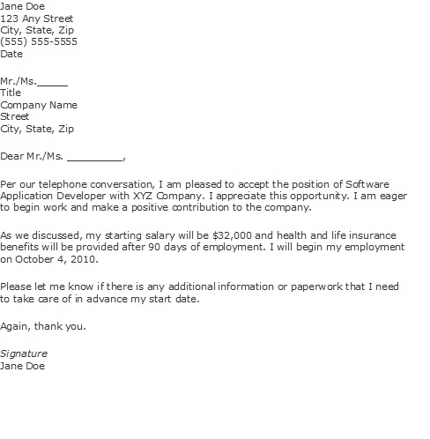
Accept the offer via telephone, then follow up with a formal acceptance letter which will confirm information such as your acceptance, your job title, your salary and benefits information, and your start date.

Slide 12
Withdrawal from the Job Search
Once you have accepted a job offer, you must formally withdraw yourself from the job search.
Notify via telephone those companies to which you have applied to let them know you have accepted a job offer and are no longer seeking employment.
Follow up with a written confirmation of your withdrawal. This can be either via e-mail or written letter.

Slide 13
Rejecting the Offer
Formally notify the company as soon as possible to give them time to either notify their second choice or begin the interview process again.
Notify employer via telephone of the rejection.
Follow up in writing either via email or written letter.
Never say anything negative, especially in the written letter.
You do not have to state the reason for rejection.
Be courteous and notify the company early and remember to thank them for the opportunity and for their consideration.

Slide 14

References
Bureau of Labor Statistics www.bls.gov/OES www.bls.gov/oco/oxo20046.htm
Monster www.career-advice.monster.com
Riley Guide http://www.rileyguide.com/offers.html#eval
Career Services at Virginia Tech http://www.career.vt.edu/jobsearc/accepting.htm http://www.career.vt.edu/jobsearc/accepting.htm

Slide 15
THANK YOU!
Kellee Crawford, Career Programs Manager Office of Career Development
111 Madison Hall
256.824.6741 – Main Office 256.824.6938 – Direct Number
kellee.crawford@uah.edu
http://ssc.uah.edu/ssc/careers

