Slide 1
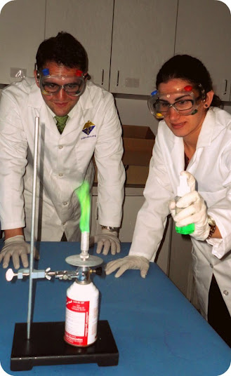
Personal Protective Equipment

Slide 2
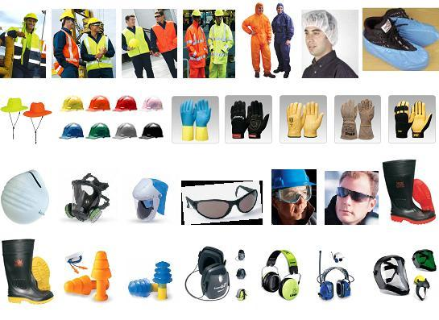
What is Personnel Protective Equipment- PPE?
PPE is defined as a device or clothing worn by a worker to help prevent direct exposure to hazards and protect workers from Bodily Injury
PPE is the least preferred method of protection, and should be used following engineering and administrative controls methods.

Slide 3
Hierarchy of Control Measures
1. Engineering Controls Most Effective Control
2. Administrative Controls
3. Personal Protective
Equipment Least Effective Control

Slide 4
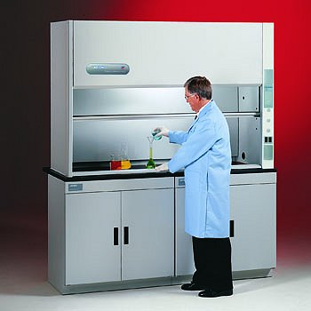
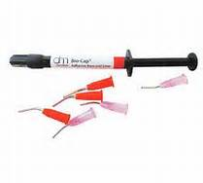
Engineering Controls
Engineering Controls are built into an operation and require no activation from the employee.
Examples include self-capping syringe needles, ventilation systems, fume hoods and substitution to a less hazardous process or chemical.

Slide 5
Administrative Controls
Are changes in work practices such as supervision, schedules, and training with the goal of reducing the duration, frequency, and severity of exposure to hazardous situations
Less effective method used when engineering controls are not feasible.
Examples…..
Examples include written operating procedures, training and limiting exposure times
Personal hygiene
Housekeeping and maintenance

Slide 6

Appropriate attire for the lab
Always wear a lab coat in the laboratory.
Do not wear tank-tops and shorts inside a lab.
Tie back or secure long hair and loose clothing.
Wear shoes that protect or cover your feet. Do not wear flip-flops, sandals or perforated shoes

Slide 7
Mandatory minimum PPE requirement
Protective eye wear
Lab coat
Long pants
Close-toed shoes
Chemical resistant gloves (when working with hazardous substances)

Slide 8
Establishing a PPE Program
First – Hazard Assessment
  Assess the workplace to determine if hazards are present, or are likely to be present, which necessitate the use of PPE
Once the proper PPE has been selected, training must be provided to everyone required to use PPE

Slide 9

Training
Employees required to use PPE must be trained to know at least the following:
When PPE is necessary
What type of PPE is necessary
How to properly put on, take
off, adjust, and wear
Limitations of the PPE
Proper care, maintenance,
useful life and disposal

Slide 10
Users Responsibilities
Attending training sessions on PPE
Properly wearing the PPE
Proper care and maintenance of the PPE
Informing the suoervisor about the need for repair and replacement

Slide 11

Eye Protection
Notes:
.

Slide 12
Eye Protection
Eye protection is required (but not limited to):
When chemicals, glassware, or a heating source is being used
When working with solid materials or equipment under stress, pressure, or force that might cause fragmentation or flying particles
When an activity generates projectiles, or uses elastic materials under stress (e.g., springs, wires, rubber, glass), or causes collisions
When dust or fumes are present
When using preserved specimen

Slide 13
Types of eye protection
Eye protection is mandatory in all areas where there is a potential for injury.
The type of eye protection required depends on the hazard. For most situations safety glasses with side shields are adequate.
Goggles or face shields are required in specific operations where there is danger from splashes of corrosive liquids or flying particles
If a splash occurs proceed to nearest eyewash fountain and flush eyes with water from the eye outward for at least 15-30 minutes.
Recommended that contact lenses not be worn in laboratory.

Slide 14
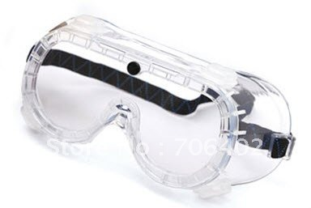
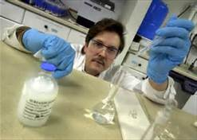
Goggles
Usually enclose or protect the eye and the facial area immediately surrounding the eyes from impact, dust, and splashes
Often worn when danger from splashes of corrosive liquids or flying particles

Slide 15
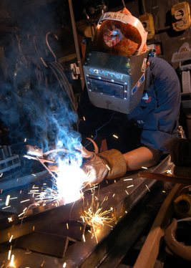
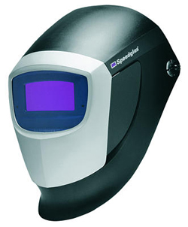
Welding Shields
Protect eyes from burns, flying sparks, metal spatter, and slag chips produced during welding, brazing, soldering, and cutting

Slide 16
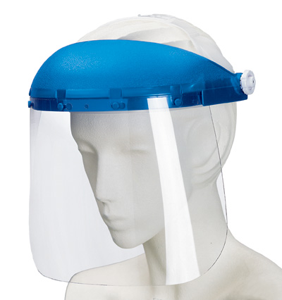
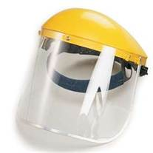
Face Shields
Device used to protect the entire face from flying objects, debris and chemical splashes or potentially infectious fluid.
Do not protect from impact hazards

Slide 17
Choosing Gloves: Compatibility
Three important properties determine the type of chemical-resistant gloves worn:
  Chemical degradation – Some chemicals cause gloves to deteriorate, rendering them useless. For example, most organic solvents will dissolve latex rubber.
  Permeation rate – The rate at which a specific chemical diffuses through glove material.
  Breakthrough time - The amount of time required for a given chemical to penetrate through a glove.

Slide 18
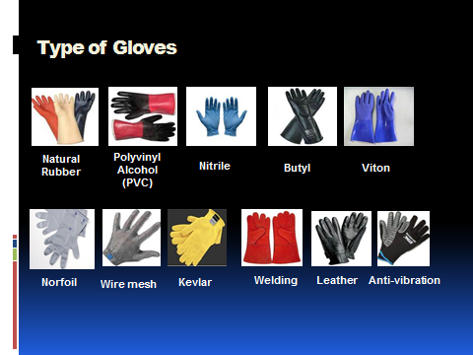
Type of gloves

Slide 19
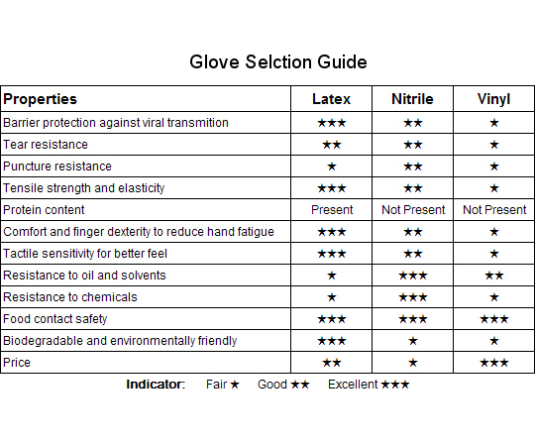
Glove compatibility chart

Slide 20
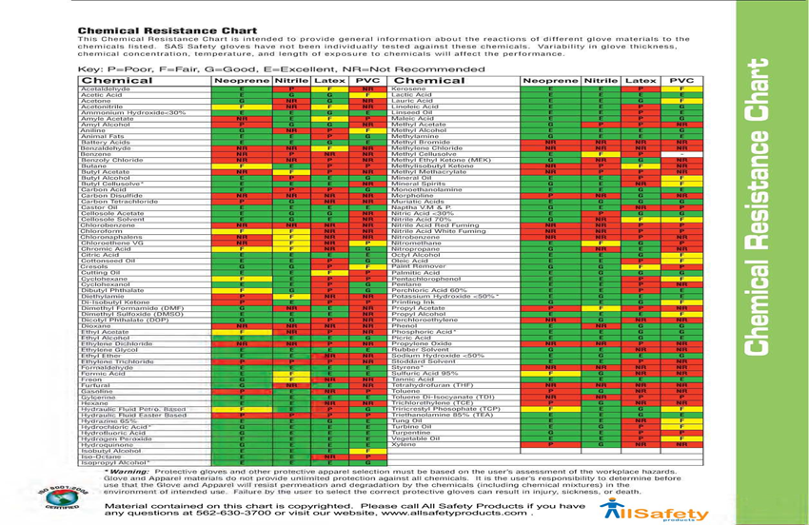

Slide 21
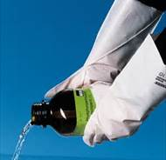
Types of Gloves cont.
Norfoil laminate resists permeation and breakthrough by an array of toxic/hazardous chemicals. Resistant to a wide range of solvents, acids, and bases
Butyl provides the highest permeation resistance to gas or water vapors; frequently used for ketones (M.E.K., Acetone) and esters (Amyl Acetate, Ethyl Acetate).

Slide 22
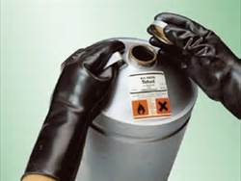
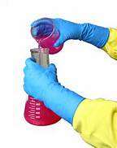
Types of Gloves cont.
Viton is made specifically for handling chlorinated and aromatic solvents, exhibit a high degree of impermeability to these solvents and can be used in or around water and water-based solutions. Viton also has superior resistance to PCBs
Nitrile provides protection against a wide variety of solvents, harsh chemicals, fats and petroleum products and also provides excellent resistance to cuts, snags, punctures and abrasions.

Slide 23
Ways to protect your skin
Choose the right PPE for the specific agent you are working with.
Cover any portion of the skin that is likely to be exposed
Examples include lab coats, aprons, sleeves, coveralls, head coverings, or protective footwear.

Slide 24
Lab coat requirements
Lab coats made of polyester-cotton blends (no less than 35% cotton) are acceptable in labs where no open flames are present.
Lab coats must be made of 100% cotton or flame resistant material in labs where open flames are used (such as alcohol burners).
Labs that store large quantities (>10gallons) of flammable liquids outside a flammable storage cabinet must use lab coats made of 100% Cotton treated with flame retardant material.
Lab coats of flame resistant (FR) material are required in labs where pyrophoric materials are handled.

Slide 25
Select lab coat/apron using the following recommendations:
Length - At least knee length or longer is recommended for most effective coverage.
Wristband - It is recommended that a lab coat with a fitted wristband/cuff be used to reduce the potential for splashes up the arm and fire hazards.
Top button - It is best to use a lab coat that provides for a high top button at the neck to provide most effective protection.
Fire resistant - Use only those constructed of a flame resistant material

Slide 26
Lab coat selection chart
Material/Source | Features | Pros | Cons
Polyester/Cotton Blend 80% Polyester / 20% Cotton, 65/35, and 40/60 are common blends. | Liquid Resistance Splash resistant. No specific chemical resistance. Better protection against corrosive material than cotton. Flame Resistance No | Appropriate for use in clinical settings and research laboratories where biological material is manipulated. | Polyester blends burn readily when ignited, and are not appropriate for use with flammable liquids, pyrophoric materials, or near open flame.
100% Cotton | Liquid Resistance Not splash resistant. No specific chemical resistance. Cotton lab coats provide better protection from solvent contamination than corrosive contamination. Flame Resistance No | Appropriate for use in clinical settings and research laboratories where there is light flammable liquid or open flame use. | Cotton lab coats should be supplemented with a chemical splash apron when corrosive material is handled.
100% Cotton treated with flame retardant. | Liquid Resistance Not splash resistant. No specific chemical resistance. Flame Resistance Yes Flame-resistant (FR) fabrics and garments are intended to resist ignition, prevent the spread of flames | Appropriate for use in research laboratories where substantial fire risk exists from flammable material handling or open flame use. Laundering will not damage the flame resistant coating. | More costly than a traditional 100% cotton lab coat.
Nomex IIIA | Liquid Resistance Flame Resistance Yes When in contact with direct flame or extreme heat, fibers in the protective clothing enlarge, enabling greater distance between the user’s skin and heat source. Comfort Breathable, but slightly bulkier than polyester blend or 100% cotton materials. | Appropriate for use in research laboratories where there is extreme fire danger from open flame, electrical arc flash, and pyrophoric material. | Expensive.
DuPont Tyvek lab coats | Liquid Resistance Barrier to particles, biological fluids, and chemicals. Flame Resistance Not flame retardant and melts at 135°C (275°F) | Appropriate for use in clinical settings and research laboratories where biological material is manipulated Excellent protection against microscopic airborne particles | Inappropriate for use in environments with a significant fire danger,

Slide 27
Protection against inhalation hazard
The use of a respirator may be necessary to protect against vapors and chemical particulates.
The keys to effective respirator use are proper fit and the selection of the appropriate cartridge
Anyone using a respirator (including N95 dust masks) must first receive a medical evaluation, approval, and training
Chemical Cartridge Color Coding All manufacturers use the same color coding for gas/vapor protection
Color | Type
White | Acid Gas
Black | Organic Vapors
Green | Ammonia Gas
Yellow | Acid Gas & Organic Vapor
Olive | Mulit-gas (protects against numerous gases and vapors)
Magenta | Particulate Filter Cartridge (HEPA) (Also called P100)
(A HEPA is a particulate filter; all others are used for gases and/or vapors.)

Slide 28

Hearing Protection

Slide 29
Examples of Hearing Protectors
Earmuffs
can reduce noise by as
much as 15 to 30 decibels
Earplugs
foam ear plugs to fit ear
canals of different sizes.
Canal Caps
provide less protection than
ear muffs or plugs,
Contact OEHS for a noise level evaluation if you suspect of noise pollution

Slide 30
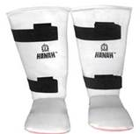
Foot Protection
Wear shoes that cover your toes.
No sandals and flip flops in the lab

Slide 31
PPE Maintenance
Always inspect PPE for damage (tears, holes, worn elastic, etc.) and contamination prior to use.
If an item cannot be properly cleaned or becomes damaged it should be discarded. When in doubt, throw it out.
Reusable PPE should be immediately cleaned after each use with the appropriate cleanser (usually soap and water

Slide 32
Proper use of PPE
Disposable items should only be used once and replaced when contaminated.
Always assume PPE is contaminated: it is worn to protect against hazardous substances.
Remove PPE prior to exiting the lab to help prevent the spread of contamination.
Be sure you know the proper methods for putting on, taking off and fit-checking any PPE worn.

Slide 33
Storage of PPE
Separate from chemicals and other contaminants.
Store away from sources of heat
Do not store under heavy objects
Be aware that some equipment may have a limited shelf life.

Slide 34
Limitations of PPE
No single PPE will protect you from all hazards.
Consider permeation rates, compatibility and degradation for the chemicals you are working with.
PPE may limit your dexterity, vision, grip strength, or comfort. Plan your work accordingly

Slide 35
Summary
Conduct a risk analysis for the workplace for likely hazards at the work place
Use engineering and work practice controls to eliminate or reduce hazards before using PPE
Educate the everyone about the importance of the PPE program and how and when to use PPE
Train everyone how to use and care for their PPE and how to recognize deterioration and failure
Employees are to required to wear the PPEs as recommended by the supervisor

Slide 36
Acknowledgement of Training
Click here to acknowledge receipt training in PPE for Labs training

Slide 37
References
OSHA Office of Training and Education
EH&S, University of California, Los Angeles
Notes:
12/2/2014

