Slide 1
Hazardous Waste Management
Office of Environmental Health and Safety
University of Alabama at Huntsville
2014

Slide 2
Objectives
To demonstrate the proper methods of laboratory hazardous waste management for compliance with state and federal regulations.
To provide accident management and spill clean-up procedures

Slide 3
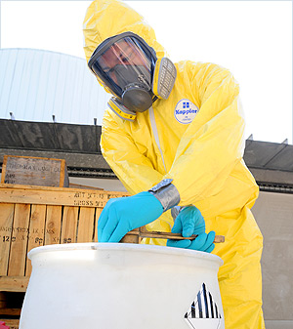
Training Topics
Regulations
Define Hazardous Waste
Container Management
Waste Labeling
Waste Compatibility
Storage Area management
Waste Minimization
Waste- Pickup
Spill Clean-up

Slide 4
Who Regulates Hazardous Waste?
Environmental Protection Agency (EPA)
Regulates all aspects of hazardous waste
Department of Transportation (DOT)
Regulates hazardous waste transportation
Department of Homeland Security (DHS)
Regulates security threats associated with chemicals.

Slide 5
Resource Conservation and Recovery Act: RCRA
Protecting human health and the natural environment from the potential hazards of waste disposal.
Reducing the amount of waste generated, through source reduction and recycling
Ensuring the management of waste in an environmentally sound manner.
"Cradle to Grave" requirements: Hazardous waste is regulated from the moment it is created through the time of final disposal. Generator is forever responsible for their waste.

Slide 6
RCRA
Under the Resource Conservation and Recovery Act (RCRA), EPA regulates individuals who generate & accumulate hazardous wastes.
All labs, studios, and shops that accumulate hazardous wastes are subject to unannounced inspections by Alabama Department for Environmental Management(ADEM) and/or EPA and can be fined.

Slide 7
Responsibilities of UAH
EPA views UAH as a hazardous waste generator
Generators are responsible for:
properly identifying hazardous waste
proper management of hazardous waste
Use
Storage
Disposal

Slide 8
Most Common EPA Violations
Most commonly cited EPA violations of hazardous waste regulations are:
Open containers or lids not screwed on tight
Improper labels/identification
Lack of secondary containment for leaks
Wastes from multiple locations consolidated in one room
The 4L’s – Lids, Leaks, Labels and Location

Slide 9
EPA Fines for Non-compliance
The EPA does impose fines against universities and colleges
Examples include:
UAH - $25,000
Boston University - $800,000
Penn State - $1 million
UC Berkeley - $1 million
Stanford University - $1 million

Slide 10
What is a hazardous waste?
Hazardous waste is waste that is dangerous or potentially harmful to our health or the environment.
Hazardous wastes can be liquids, solids, gases, or sludge.
They can be discarded commercial products, like cleaning fluids or pesticides, or the by-products of manufacturing processes.
Hazardous waste are divided into:
Listed wastes
Characteristic wastes

Slide 11
Listed and Acutely Toxic Waste
EPA-listed wastes:
F-list: This list identifies wastes from common manufacturing and industrial processes, such as solvents that have been used in cleaning or degreasing operations
K-list (source-specific wastes). This list includes certain wastes from specific industries, such as petroleum refining or pesticide manufacturing
P-list and the U-list (discarded commercial chemical products). These lists include specific commercial chemical products in an unused form.
All EPA P-listed wastes are acutely toxic

Slide 12
Characteristic Waste
Ignitable
Corrosive
Reactive
Toxicity

Slide 13
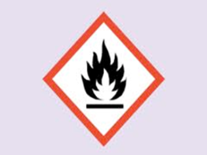
Ignitable
A liquid with a flash point below 60º (140ºF)
A non-liquid, which under standard conditions is capable of causing fire through friction, absorption of moisture, or spontaneous chemical changes
An ignitable compressed gas
An oxidizer, such as permanganate, inorganic peroxide, or nitrate
Examples include ethanol, sodium nitrate, hydrogen gas, xylene and acetone

Slide 14
Reactivity Characteristic
A waste is reactive if it meets any of the following criteria:
It can explode or violently react when exposed to water or under normal handling conditions
It can create toxic fumes or gases when exposed to water or under normal handling conditions
Examples include sodium metal, reactive sulfides, potassium cyanide and picric acid

Slide 15
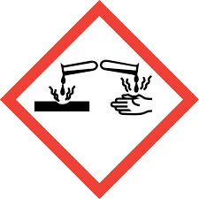
Corrosive and Toxic Characteristic
The corrosivity characteristic identifies wastes that are acidic or alkaline (basic). Such wastes can readily corrode or dissolve flesh, metal, or other materials.
Liquid with a pH less than or equal to 2 or a pH greater than or equal to 12.5. Examples: hydrochloric acid, glacial acetic acid
A Toxic waste is a material that can be harmful or fatal if you are exposed and can pollute groundwater if released on land. Toxic wastes are listed by EPA. There are currently 40 contaminants on the list that include certain heavy metals, pesticides and organic compounds. Examples: lead-based paints, cadmium, arsenic

Slide 16
Hazard Symbols

Slide 17
Peroxide Formers and Time Sensitive Chemicals
Some chemicals if stored too long can produce organic peroxides capable causing explosions under heat or friction. The unusual stability problems of this class of compounds make them a serious fire and explosion hazard.
Examples:
Ethers
Tetrahydrofuran
Picric/Picrylsulfonic Acid

Slide 18
How to Handle Peroxide Formers?
Do Not Attempt to Open Expired Peroxide Formers
Time-Sensitive Chemicals
Check for crystallization periodically
Dispose of no later than 12-18 months after purchase
Call OEHS #2171 to pick up all expired chemicals

Slide 19
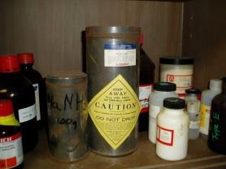
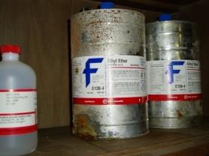
Reactive Chemicals
Old or expired reactive chemicals can be potentially dangerous
Peroxide formers such as ether should not be handled
Notify OEHS immediately if found in your lab

Slide 20
Who makes the Hazardous Waste Determination?
Environmental Health & Safety has the final determination of whether a waste is hazardous and its proper disposal.
Therefore, all accumulated chemical wastes should be treated as hazardous wastes.
No Chemical Wastes Down The Drain or in the Trash!
Dilution is not the pollution solution.
Contact OEHS for waste pick-up

Slide 21
If unsure whether the waste created is hazardous:
Consult your supervisor.
Consult with EPA Waste lists.
Refer to the products Material Safety Data Sheet.
Contact the Environmental Health and Safety Office # 2171

Slide 22
Container Management
Chemical waste must be stored in containers (including lids) composed of materials that are compatible with the waste.
Chemical waste containers must be in good condition and free of leaks and residue on the outside of the container.
Keep containers closed at all times except when adding or removing contents. Evaporation of wastes is a violation.
For liquids, fill containers to about 90% of container volume. Do NOT fill containers to the top. Leave at least 2 inches of space in liquid waste containers to allow for liquid expansion and decanting.

Slide 23
Container Management
Flammable liquids – original manufacturers or UL listed containers
Concentrated acids or bases-Original containers, or 2.5 Liter ‘acid’ safety bottles
Solid waste – Plastic high density polyethylene bottles
Aqueous waste-glass bottles or HDPE plastic bottles
Milk jugs, soda bottles and food containers unacceptable.

Slide 24
Closing Chemical Waste Containers
Chemical waste containers must be tightly closed to prevent leakage or spillage.
Containers should be closed with a screw-type lid or other appropriate device.
Plastic wrap, aluminum foil, parafilm and other temporary lids are unacceptable.
A container holding chemical waste must ALWAYS be closed, except when waste is actually being added.
If a waste container is used to collect waste from a continuous process (i.e., drainage from a process collected with tubing inserted into a bottle such as HPLC), the container must still be sealed using rubber stoppers with tubing inserts or other appropriate means. It is not acceptable to leave funnels in chemical waste containers.

Slide 25
Example – Open Containers
Lid open when not in use
A funnel is not a lid!

Slide 26
Chemical Waste Labeling
All chemical waste containers must be have yellow chemical waste label affixed on the bottle
Available from OEHS
The following information must be provided on the label (see example of the label later in this section):
PI Name or Generator name
Building
Room number
Telephone number
Exact contents of the container

Slide 27
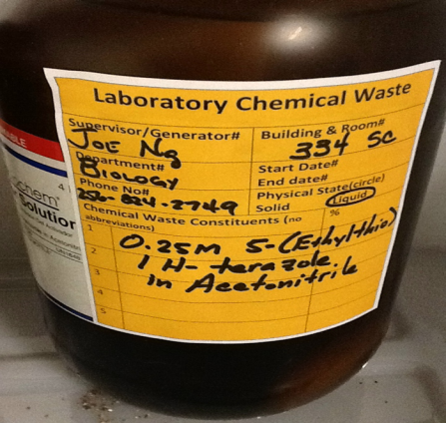
Yellow Waste Label

Slide 28
Satellite Accumulation Area: SAA
A specific area should be designated in the laboratory as a chemical waste storage area. The area must be marked with “Waste Storage Area” signage (available with OEHS and Department Office)
Waste must be stored in the room it was generated in and cannot be transferred to any area that requires passage through a door.
Chemical waste must be stored with secondary containment so that spills cannot reach sinks, or floor drains.
Incompatible chemical wastes must be segregated to prevent reaction.

Slide 29
Satellite Accumulation Area: SAA
Satellite Accumulation Area (SAA)
- At or near the related work process
- Under the control of the generator
- Maximum amount stored 55 gallons or 1
quart acutely hazardous
Secondary containment and weekly inspections are strongly recommended.

Slide 30
Segregation of Waste at SAA
Separate by hazards
flammable
toxic
corrosive
reactive
Separate by distance and containment.

Slide 31
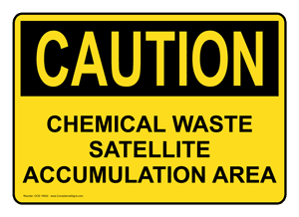
SAA Warning Signs

Slide 32
SAA management
Waste containers stored in a SAA must be:
In good condition
Compatible with the waste being stored
Kept closed at all times except when filling
Labeled with a yellow chemical waste label from OEHS
Stored inside secondary containment bins
Original containers of unused materials do not need a waste label if the original label is clearly legible
Waste must always remain in the lab
Never store waste in PUBLIC AREAS (such as hallways)

Slide 33
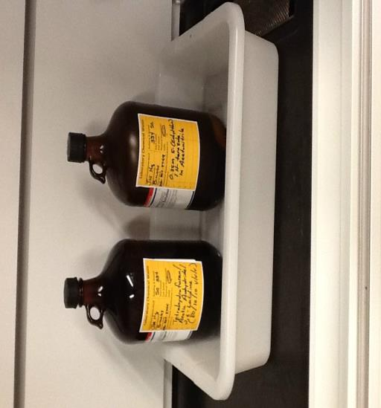
Clean SAA

Slide 34
Mixing Waste
Divide wastes into separate waste streams
Acids Bases
Oxidizers Solids
Photographic waste Mercury

Slide 35
Mixing Chemical Waste
Mixing a hazardous waste with a non-hazardous waste may increase the volume of hazardous waste for disposal or increase disposal costs due to differences in disposal options for certain hazardous wastes.
DO NOT mix incompatible materials in the same container.
Consult with OEHS prior to mixing different chemical wastes.

Slide 36
Mixing Hazardous Waste
Solvents should be separated where possible as halogenated (chloroform and methylene chloride) and nonhalogenated waste (propanol, methanol, and toluene).
Inorganic wastes containing barium, lead and cadmium may be mixed together.

Slide 37
Empty Containers
A container of a non-acute hazardous waste, other than a pressurized cylinder, is empty if:
All wastes have been removed that can be removed through, and
If the container is less than or equal to 119 gallons no more than one inch of residue remains on the bottom of the container, or no more than 3 percent by weight of the total capacity of the container remains;
A compressed gas cylinder that contained hazardous material is empty when the pressure in the container approaches atmospheric pressure.
Empty plastic and brown glass chemical containers may be rinsed with water and disposed of in a sealed box with trash. Caps must be removed and labels must defaced and marked “EMPTY”.

Slide 38
Empty Containers of Acutely Hazardous Waste
Empty containers that contained acutely hazardous wastes are managed as hazardous wastes

Slide 39
NON-HAZARDOUS WASTE
Materials that are not considered hazardous waste must be disposed as solid waste.
Empty containers must have the labels defaced or removed.
Paper products that are not saturated with hazardous materials and/or biomedical waste can be disposed as non-hazardous waste.
Broken glass and pipettes must be placed in a broken glass rigid disposal container.

Slide 40
Sharps Disposal
Sharps containers for disposal of these items should be conveniently located and easily accessible in all work places where sharps are used.

Slide 41
Waste Minimization
Practice the concept of Source Reduction by simply ordering the smallest quantity of chemical materials
Keep an inventory of chemicals on hand.
Share surplus chemical with other labs.
Purchase mercury-free instruments.
Substitute hazardous chemicals with non-hazardous chemicals whenever possible.
Reduce the scale of laboratory experiments to reduce the volume of waste being produced whenever possible.

Slide 42
Waste Pick-up
Picked up by OEHS per specific building schedule or by request.
The Chemical Disposal Inventory Form must accompany all waste and surplus chemicals.
Waste containers must be stored for pick up in the room in which they were generated
Chemical wastes must NOT be disposed of by evaporation. This includes evaporation in fume hoods or biosafety cabinets.
It’s free!!!!

Slide 43
Waste Inventory Sheet
Chemical Name | Number of Containers | Size of Containers | Chemical Suitable for Reuse/Exchange Y/NO | Special hazards
Total number of containers on page:

Slide 44
On-Site Hazardous Materials Management
Annual review of chemicals
Removal of surplus chemicals and chemical waste
Evaluate gas cylinders, unknowns & potential explosives
Laboratory and Stockroom cleanouts

Slide 45
Spill Clean up
When responding to a small chemical or hazardous waste spill,
REFER SDS for the material’s hazards and
Potential to react with other materials
Contact OEH&S for spill clean-up assistance when:
Large spills
Spills involving extremely hazardous chemicals
Inadequate ventilation in spill area
No spill clean-up materials
Personnel uncomfortable handling clean-up
If a spilled chemical enters the drain, soil or water body

Slide 46
When Cleaning a Spill
Consult MSDS & wear proper PPE prior to clean-up.
Spread absorbent around and over liquid’s surface
Collect wet absorbents & transfer them in plastic bucket or bag using dustpan & brush
Label the contents of bucket/bag using yellow waste tags.
Call OEHS for waste pick-up

Slide 47
Accident management
Dial 911 on campus for emergencies
Call Office of Environmental Health & Safety
for assistance with spills that you are uncomfortable handling
to clean up mercury spills
After hours or on weekends call campus police to contact OEHS staff

Slide 48
Summary
Containers must be in good condition.
The waste placed in the container must be compatible with the container.
Containers must be clearly and legibly labeled with the yellow “Chemical Waste Label”
The label must be firmly attached to the container.
Containers must be placed next to or near the process that generates the waste.
Containers must be kept closed at all times except when adding or removing waste.
Containers must be segregated by hazard class (e.g. acids from bases and flammables).
Containers and area must be inspected at least weekly for leakage.

Slide 49
Acknowledgement of Training
Click here to acknowledge receipt of training
Contact OEHS at 824-6053 for any questions or
www.uah.edu/oehs

